Slide 1
Introduction to Use-case Diagram
Prepared By Dr. Chetna
Object Oriented Software Engineering (OOSE)

Slide 2
Index
What is Unified Modeling Language
Use Case Modelling
Components of Use Case Modelling
Finding of Use Case
Describing Use Case
Practice Question-Library Management System
Practice Questions - Hospital Management System/ Online shopping system/Banking System for Learning
Practice Questions

Slide 3
Unified Modeling Language
The Unified Modeling Language (UML) was developed jointly by Grady Booch, Ivar Jacobson, and Jim Rumbaugh with contributions from other leading methodologists, software vendors, and many users. The UML provides the application modeling language for:
Process modeling/ Requirement Analysis with Use-cases.
Static Design with Class and object modeling.
Dynamic Design with sequence, collaboration and activity diagrams.
Realtime Systems design models
Distribution and deployment modeling.

Slide 4
Phases of System Development
Requirement Analysis
The functionality users require from the system
Use-case model
OO Analysis
Discovering classes and relationships
Class diagram
OO Design
Result of Analysis expanded into technical solution
Sequence diagram, state diagram, etc.
Results in detailed specs for the coding phase
Implementation (Programming/coding)
Models are converted into code
Testing
Unit tests, integration tests, system tests and acceptance tests.

Slide 5
Use-Case Modeling
In use-case modeling, the system is looked upon as a black box whose boundaries are defined by its functionality to external stimuli.
The actual description of the use-case is usually given in plain text. A popular notation promoted by UML is the stick figure notation.
We will look into the details of text representation later. Both visual and text representation are needed for a complete view.
A use-case model represents the use-case view of the system. A use-case view of a system may consist of many Use-case diagrams.
An use-case diagram shows (the system), the actors, the use-cases and the relationship among them.

Slide 6
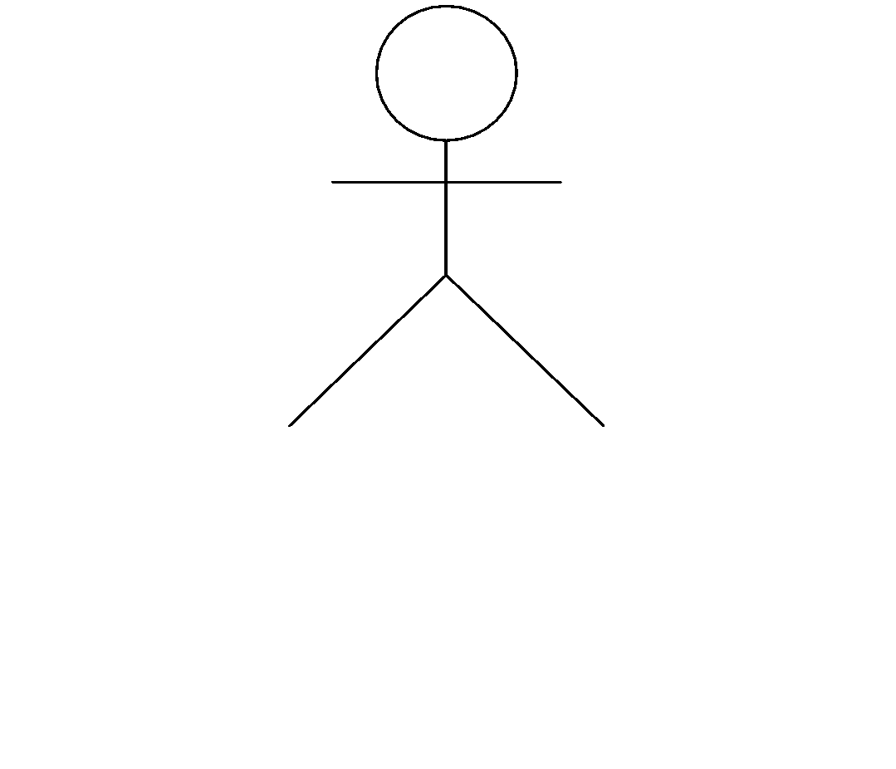
Components of Use-case Model
The components of a Use-case model are:
System Modeled
Actors
Use-cases
Stimulus
System Name
name
Use-case

Slide 7
System
As a part of the use-case modeling, the boundaries of the system are developed.
System in the use-case diagram is a box with the name appearing on the top.
Define the scope of the system that you are going to design with your MyRo. (software scope)
MyRo Software Appln.

Slide 8
Actors
An actor is something or someone that interacts with the system.
Actor communicates with the system by sending and receiving messages.
An actor provides the stimulus to activate an Use-case.
Message sent by an actor may result in more messages to actors and to Use-cases.
Actors can be ranked: primary and secondary; passive and active.
Actor is a role not an individual instance.

Slide 9
Finding Actors
The actors of a system can be identified by answering a number of questions:
Who will use the functionality of the system?
Who will maintain the system?
What devices does the system need to handle?
What other system does this system need to interact?
Who or what has interest in the results of this system?

Slide 10
Use-cases
A Use-case in UML is defined as a set of sequences of actions a system performs that yield an observable result of value to a particular actor.
Actions can involve communicating with number of actors as well as performing calculations and work inside the system.
A Use-case
is always initiated by an actor.
provides a value to an actor.
must always be connected to at least one actor.
must be a complete description.

Slide 11
Finding Use-cases
For each actor ask these questions:
Which functions does the actor require from the system?
What does the actor need to do?
Could the actor’s work be simplified or made efficient by new functions in the system?
What events are needed in the system?
What are the problems with the existing systems?
What are the inputs and outputs of the system?

Slide 12
Describing Use-cases
Use-case Name:
Use-case Number: system#.diagram#.Use-case#
Authors:
Event(Stimulus):
Actors:
Overview: brief statement
Related Use-cases:
Typical Process description: Algorithm
Exceptions and how to handle exceptions:

Slide 13
Example
Number: A.132.4
Name: Buy book online
Author: B.Ramamurthy
Event: Customer request one or more books
System: Amazon.com
Overview: Captures the process of purchasing one or more books and the transactions associated with it.
Related Use-case: A.132.5, A.132.8
Typical Process Description with exceptions handled.
NOTE : All these can be in a tabular form, say, in an Excel worksheet for example.

Slide 14
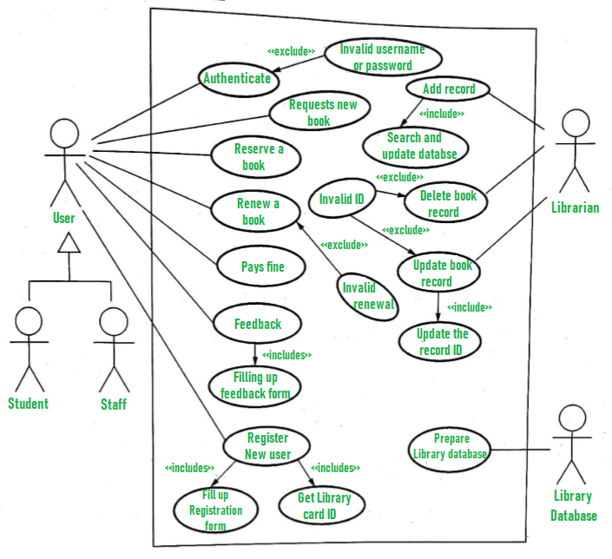
Library Management System

Slide 15
Explanation
Here, use case diagram for the library management system is here described. Some scenarios of the system are as follows :
User who registers himself as a new user initially is regarded as staff or student for the library system.
For the user to get registered as a new user, registration forms are available that is needed to be fulfilled by the user.
After registration, a library card is issued to the user by the librarian. On the library card, an ID is assigned to cardholder or user.
After getting the library card, a new book is requested by the user as per there requirement.
After, requesting, the desired book or the requested book is reserved by the user that means no other user can request for that book.
Now, the user can renew a book that means the user can get a new due date for the desired book if the user has renewed them.
If the user somehow forgets to return the book before the due date, then the user pays fine. Or if the user forgets to renew the book till the due date, then the book will be overdue and the user pays fine.

Slide 16
Explanation(Cont..)
User can fill the feedback form available if they want to.
Librarian has a key role in this system. Librarian adds the records in the library database about each student or user every time issuing the book or returning the book, or paying fine.
Librarian also deletes the record of a particular student if the student leaves the college or passed out from the college. If the book no longer exists in the library, then the record of the particular book is also deleted.
Updating database is the important role of Librarian.

Slide 17
Practice Example
Hospital Management System/ Online shopping system/Banking System for Learning
https://online.visual-paradigm.com/diagrams/templates/use-case-diagram/hospital-management-system-/
https://online.visual-paradigm.com/diagrams/templates/use-case-diagram/online-shopping-system/
https://online.visual-paradigm.com/diagrams/templates/use-case-diagram/stock-trading-platform-/
https://online.visual-paradigm.com/diagrams/templates/use-case-diagram/social-networking-platform-use-case-diagram/

Slide 18
Frequently Asked Questions
Q #1) What is the difference between a use case diagram and a use case?
Q #2) What information is contained in a use case diagram?
Q #3) What is an example of a use case?
Q #4) What is included in the use case diagram?
Q #5) Name a few UML diagram tools.

